Slide 1
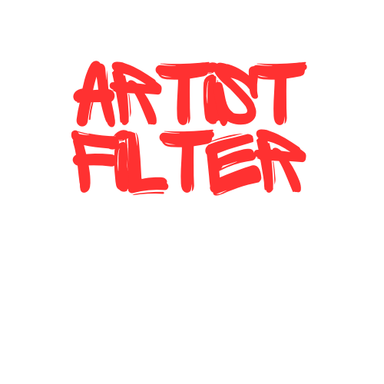
Artist Filter
2023 Fall CS593 A1 Group 1
YANG XING | XINXIAN WANG

Slide 2
Problem Statement
Objective:
Develop a range of artistic video filters (Sketch, Cartoon, Old Film, Snow) for real-time use, with a user-friendly GUI for video upload, filter selection, and instant transformation.
Motivation:
Our project introduces a way to enhance videos, catering to the growing demand for creative digital expression. It is designed to improve visual quality, making artistic transformations accessible and engaging for everyone.

Slide 3
Background
Market Gap :
The project responds to the market's lack of real-time, user-friendly video artistic filters, unlike the existing photo-focused apps like Instagram and Meitu.
Digital Creativity :
Cater to the growing demand for creative video enhancements, offering unique artistic effects.
Innovative Approach :
Focus on the development of video editing tools, a currently under-developed segment of the digital arts application space.

Slide 4
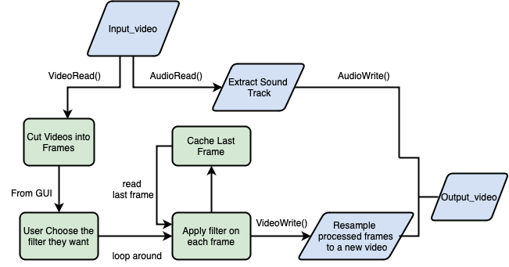
Flowchart

Slide 5
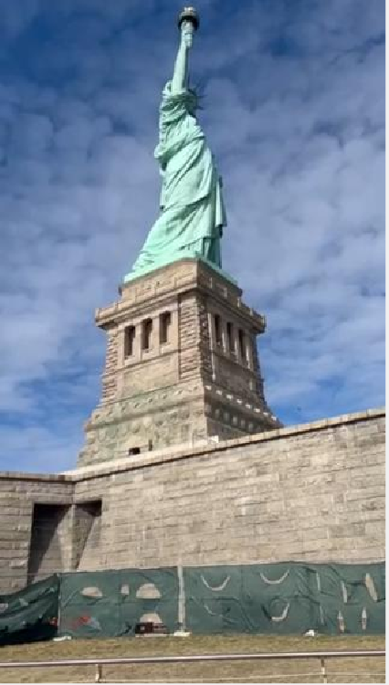
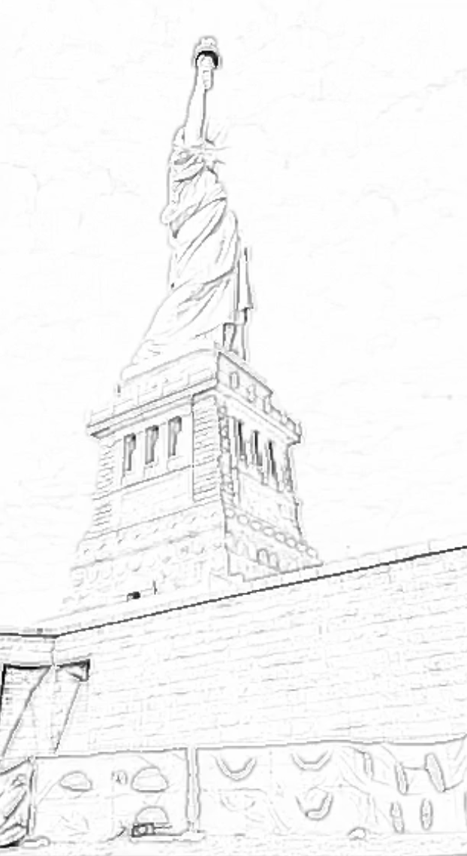
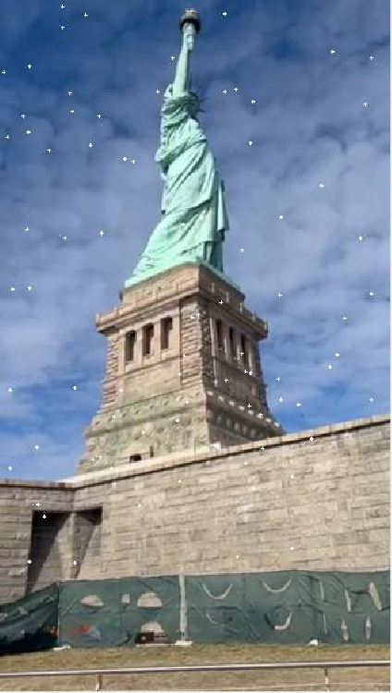
Filter Results
Filters that have high performance on videos:
An image of a frame
Sketch Filter
An image of a frame
Snow Filter

Slide 6
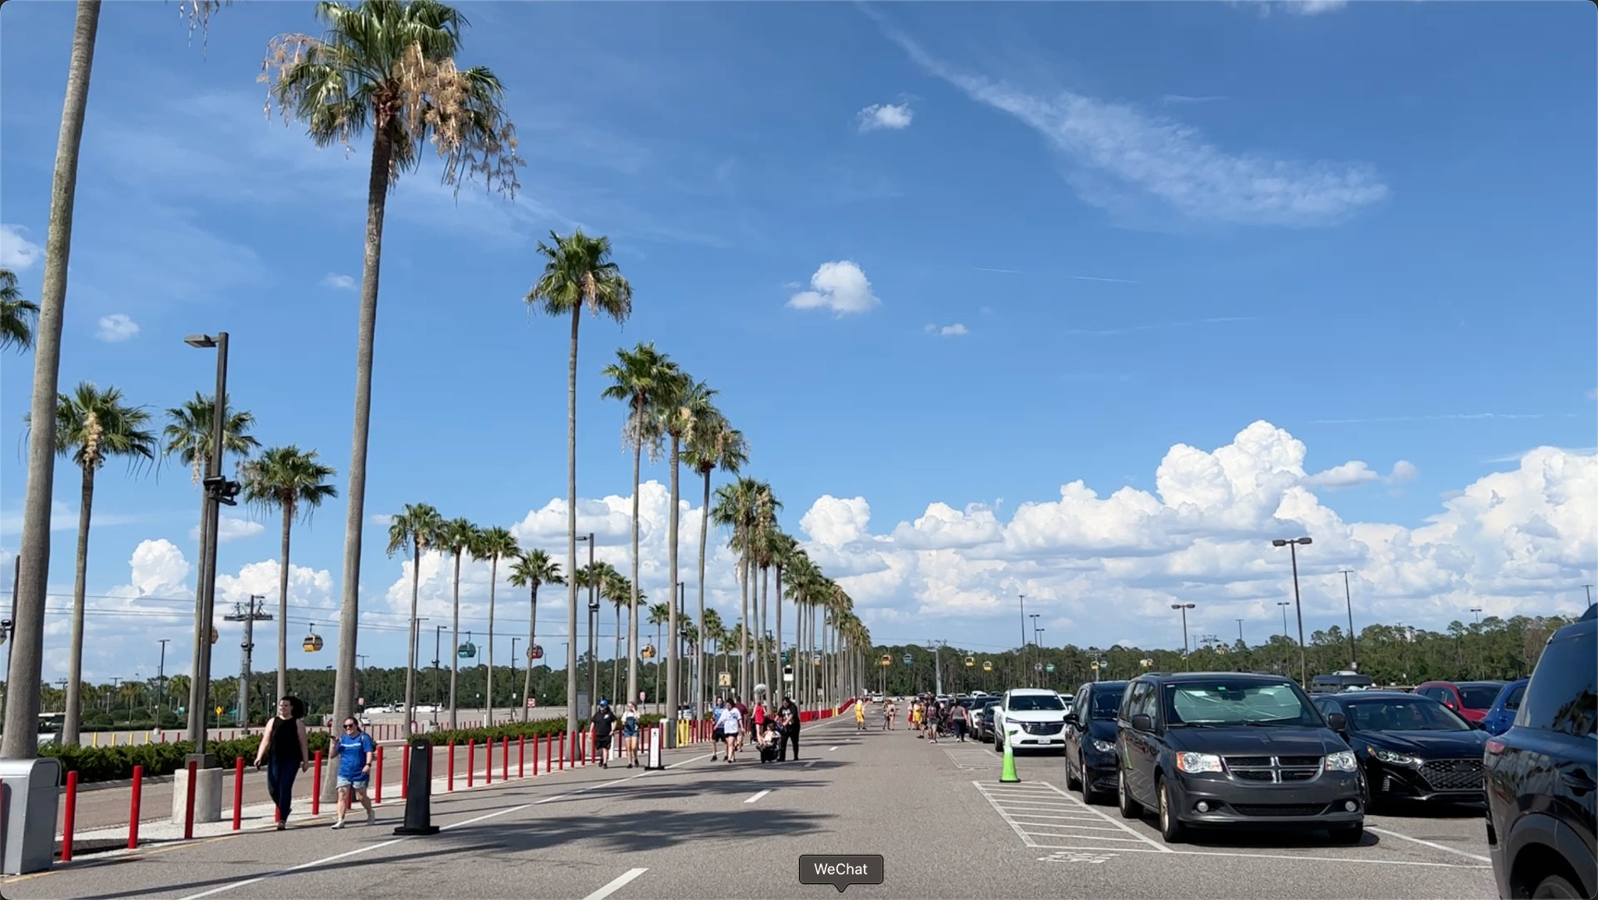
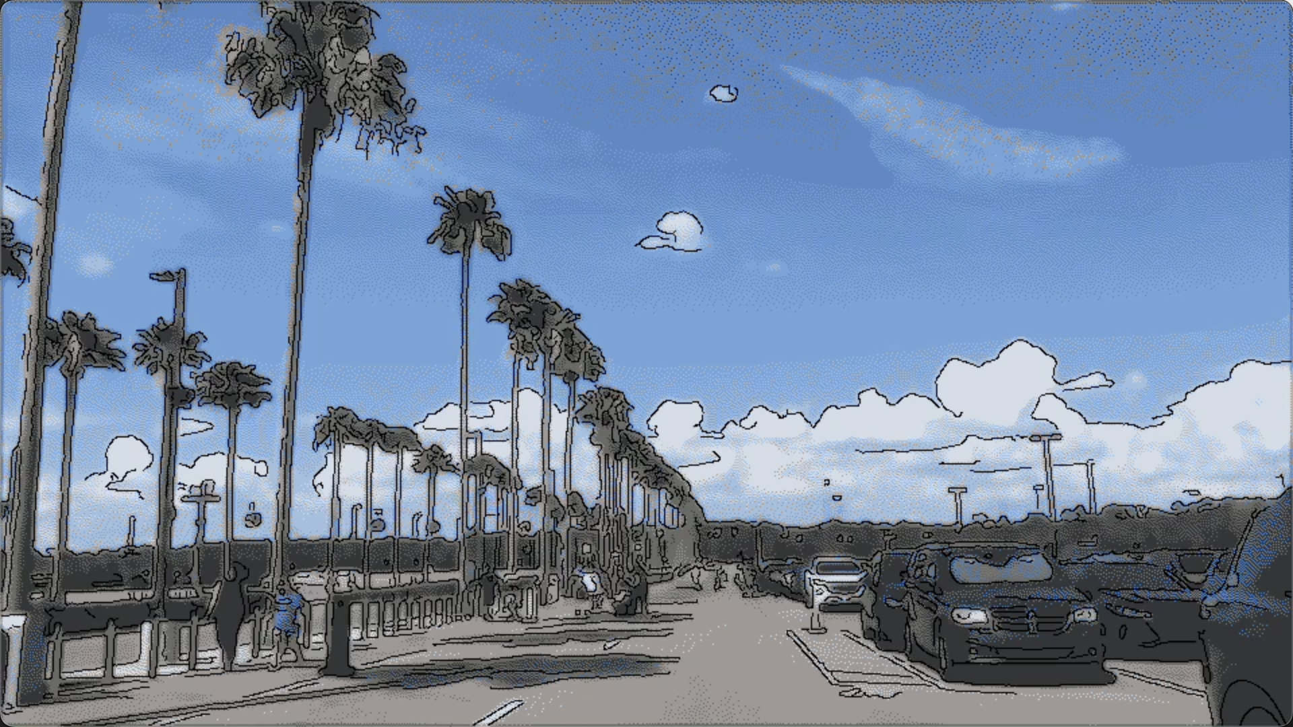
An image of a frame
Cartoon Filter

Slide 7
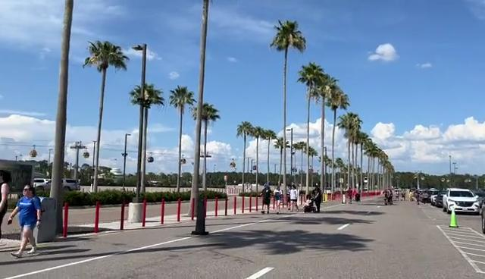
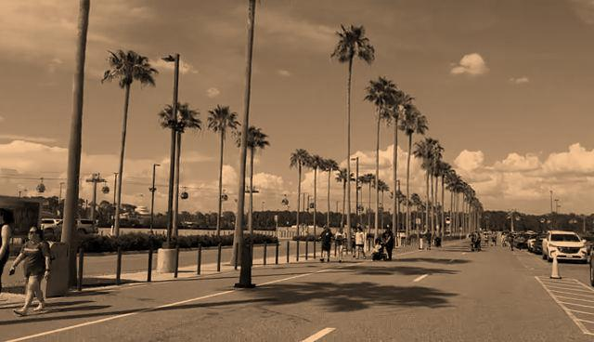
An image of a frame
Old Film Filter

Slide 8
Acquisition and Sample Analysis
Acquisition Method: A mix of stock images, public videos, and user-generated content were used for testing.
Pilot Samples: Selection of different images and videos to test filter across different scenarios.

Slide 9
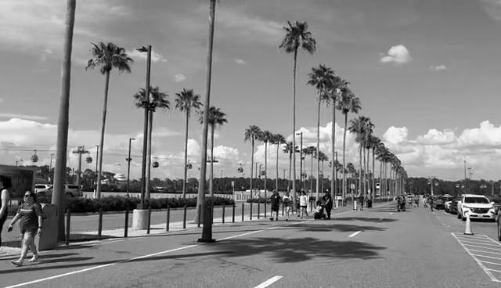
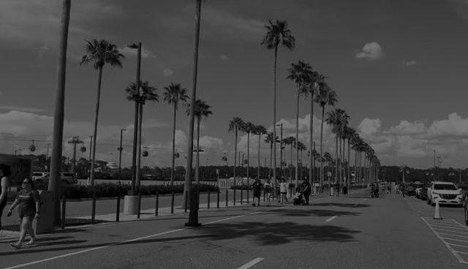
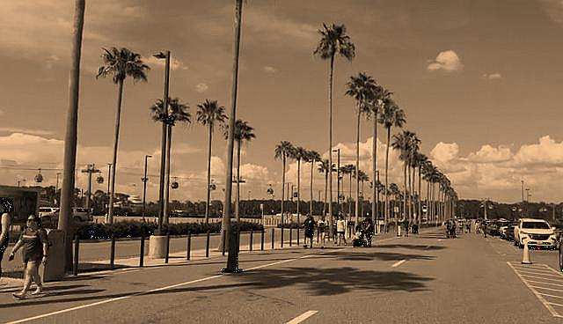

Step-by-Step Progress
Old film filter:
Grayscale Conversion
Desaturation
An image of a frame
Sepia Tone Addition
Sharpening
Noise Addition

Slide 10
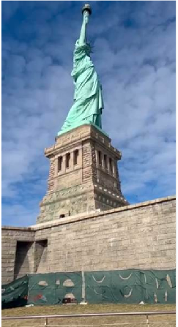

Step-by-Step Progress
Snow filter:
Initialization position
Associate
Initialize snowflake positions
Simulate Snowflake Movement
Associate
Visualize Updated Snowflake Positions
Filter Results

Slide 11
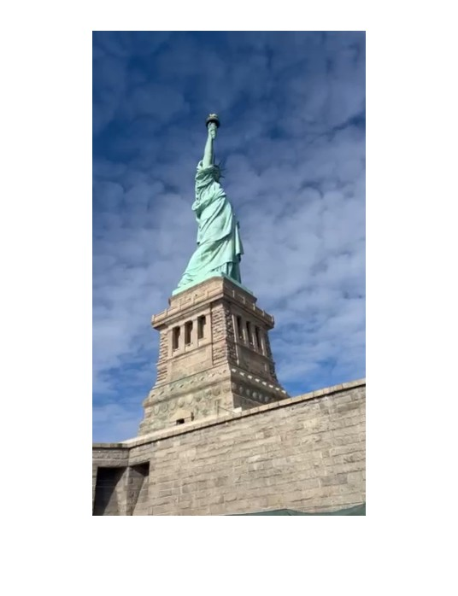
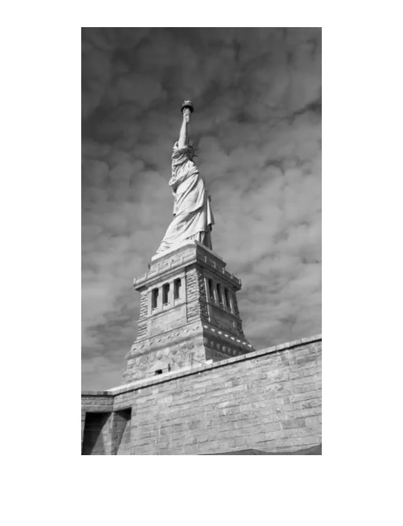

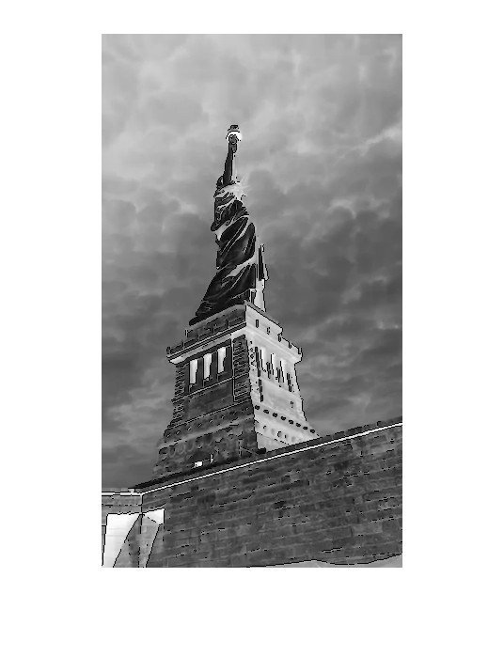

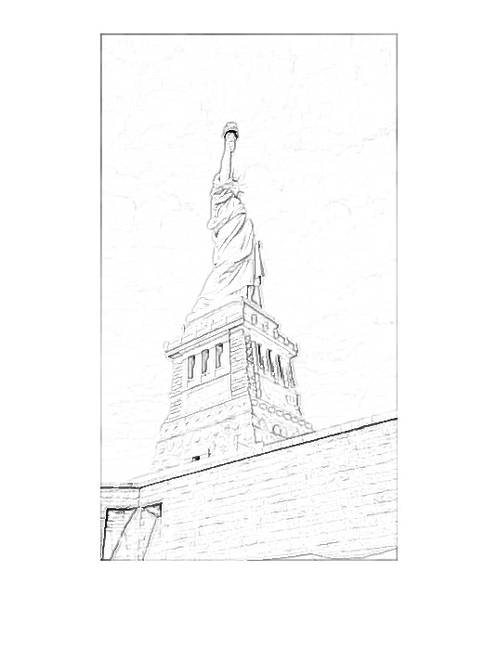
Step-by-Step Progress
Sketch filter:
Frame
Grayscale
Sharpening
Reverse
Gaussian
Sketch

Slide 12
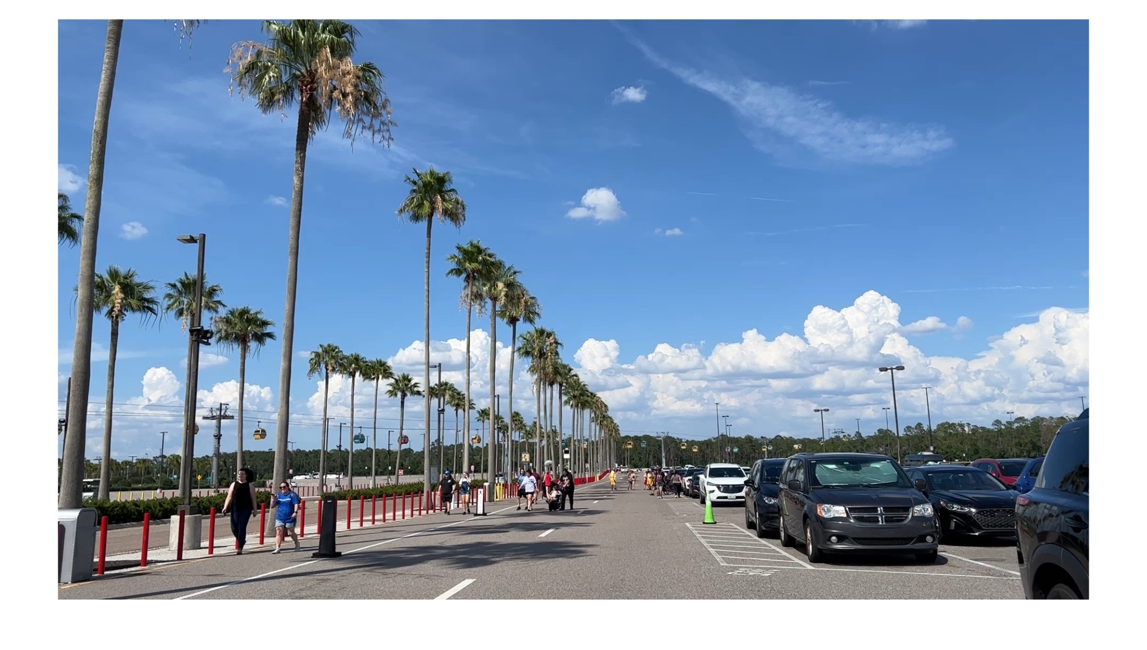
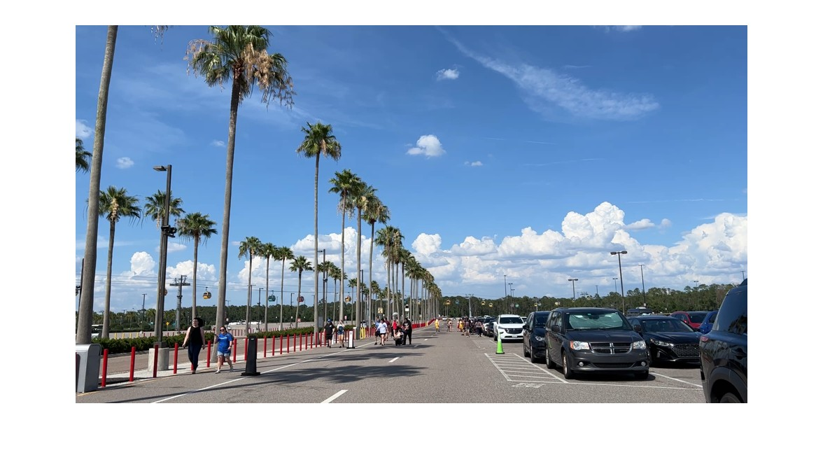
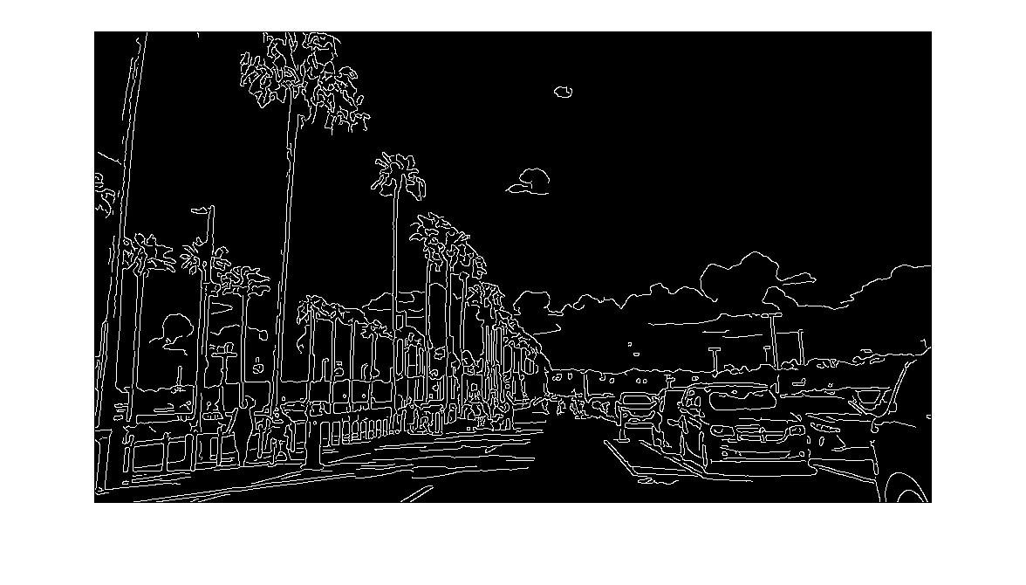

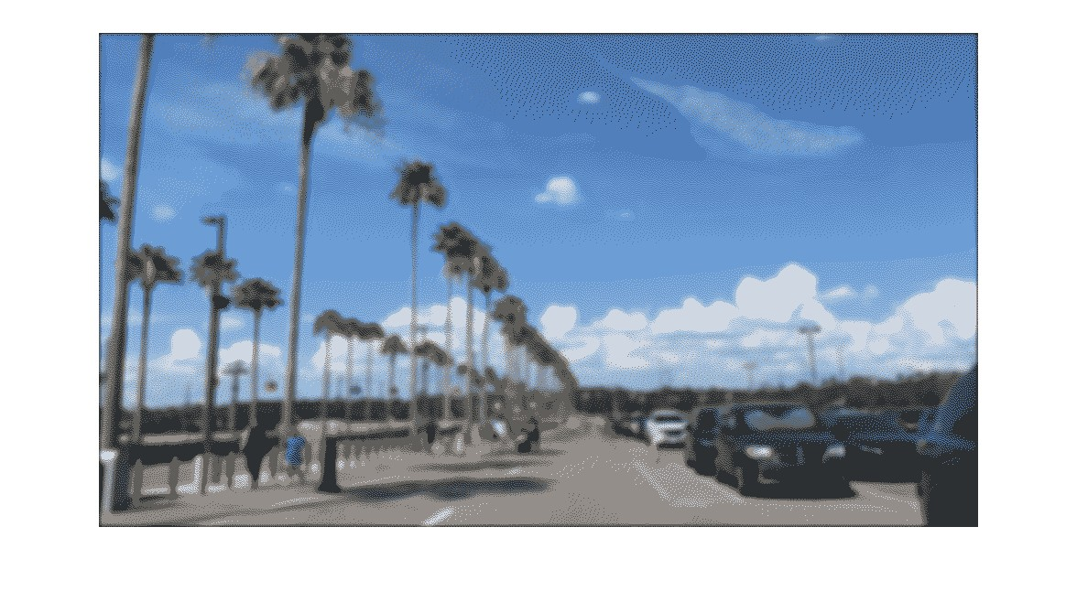
Step-by-Step Progress
Cartoon filter:
Extract
Edge
Resize
Gaussian Filter
Color
Reduction

Slide 13
Technical Methodology
Algorithms:
Cartoon Filter: Canny Edge Detector, Gaussian filtering
Sketch Filter: Gaussian Smoothing Filter, Sober Edge
Snow Filter: Morphological Image Processing
Old Film Filter: RGB transformation, Image Enhancement

Slide 14
Challenges
Story:
project goal: to make artistic filters for videos. As we moved forward, we found difficult to balance creative quality with the need for quick, real-time processing.
Failed Methods:
Video Frame Processing: Effects of videos after applying filters struggles with frame similarities, leading to inconsistent effects. Smoothing method causes lower quality when the camera angle shifts.
Processing Time: Some good filters such as bilateral filter related to gradient calculation requires huge time for computation and turns out useless for the project.

Slide 15
Conclusions
Learnings:
Algorithm Efficiency: Optimizing algorithms such as the resize trick enhances performance and accelerates the processing speed.
Testing Approach: Thorough testing, including negative cases, is vital for refining filters across various scenarios.
Design Focus: The need for a GUI leads to iterative design for ease of use.

Slide 16
Conclusions
Proposal Changes:
Adaptive Filters: Approach adjusts to develop filters that adapt to video contexts.
Enhanced GUI: User interface evolves through revisions for improved usability and feedback.
Optimization for Speed: Project focus shifts to prioritize processing speed for a real-time experience.

Slide 17
Demo!

Slide 18
Thank you for listening!
Questions?

